Slide 1
Advance Topics in Computer Graphics
Mr. Aoun-Haider

Slide 2
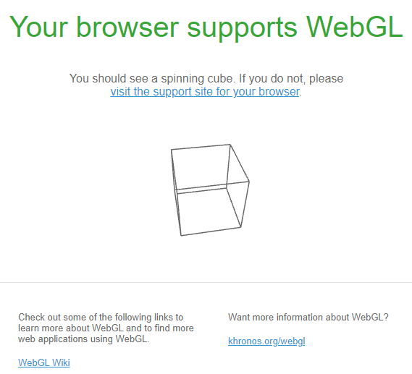
WebGL setup:
Type https://get.webgl.org/ in your browser to verify that your browser supports WebGL or not. It will show interface similar to below one:

